Slide 1
Ranger Buddy Competition 2025
Fort Leavenworth, Kansas 27-29 MAR 25
Notes:
1

Slide 2
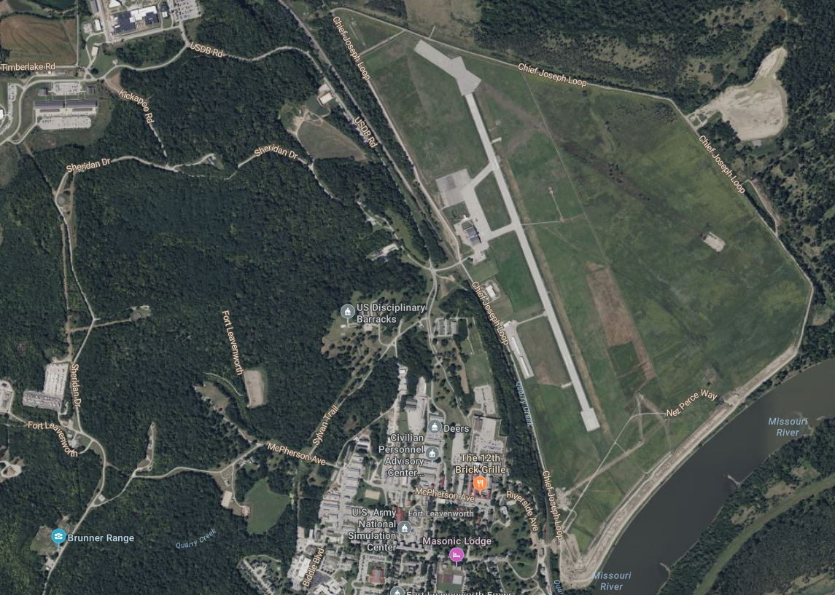
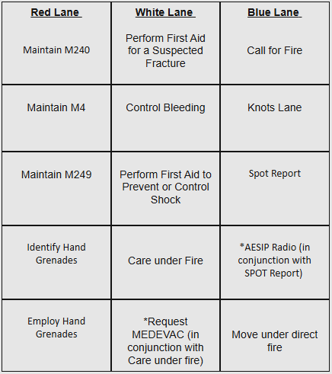
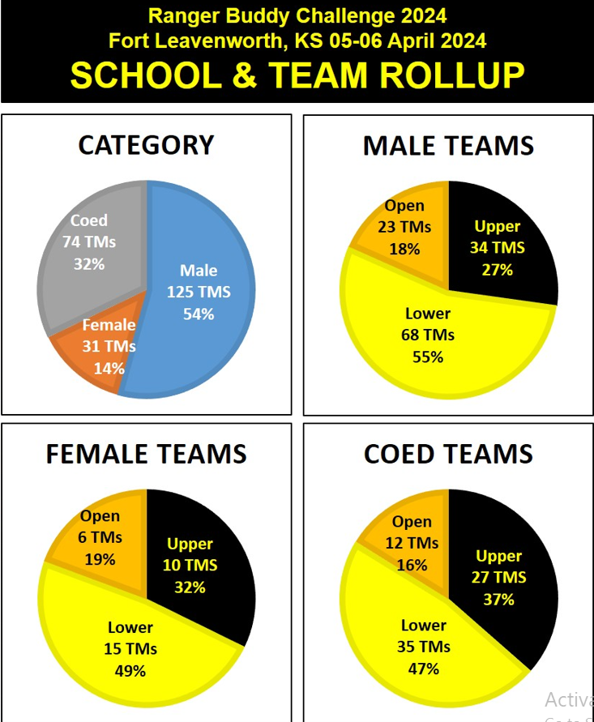
Mission: 3rd Brigade conducts Ranger Buddy Competition, under the direction of the University of Kansas, Jayhawk Battalion, at Fort Leavenworth, KS on 290700-1830MAR25 to instill a culture of winning and excellence across Cadet Command while maximizing the event as an ROTC marketing opportunity.
Concept of Operation: This operation is conducted in three phases. Phase I- RSOI, Phase II- Execution, Phase III- Awards Ceremony and Dismissal. Decisive to this operation is execution of warrior tasks during PH II.
Phase 0- Planning, OPORD/Registration dissemination, Rehearsals, Social Media Hype Train. OPORD Distro NLT 20DEC25. Registration window 20JAN-01MAR25.
Phase I- RSOI- Critical to this phase is the reception of all competitors at Fort Leavenworth, KS NLT 281800MAR25. Prior to the reception of competitors all teams must register at Link. Competitors and coaches are invited to attend IPR’s held by KU starting on 01MAR25.
PH II- Execution- Critical to this phase is the execution of tactical lane tasks. This phase begins with a written land navigation exam on 28MAR and ends with the completion of tactical lanes on 29MAR. During this phase competitors will complete 15 tactical tasks and a 13.5-mile road march.
Ph III- Award/Recovery- This phase begins o/a 291800MAR25. Critical to this phase is the recognition and awarding of best Ranger Buddy teams.
Task Force CP
Red Lane
(Weapons)
White Lane
(Medical)
Blue Lane
(Patrolling)
Historical Weather: HI: 60 LO: 30
Precipitation: 4%
Road March
RBC 24-220 Teams
39 Total Schools
33 Schools registering 5+ Teams.
RBC 25-250+ Teams
JROTC: Ranger Buddy 7k
SROTC Information Tent
Tour/ Overview of competition
7k foot race in conjunction with SROTC competitors
Recognize winners at awards ceremony: Trophies, Coins
History:
KU has hosted Ranger Buddy Competition since 1996. This year marks the 29th annual competition.
RBC is focused on retention and training of Cadets across Cadet Command through incentivized CAIT slots and nesting with Policy letter 9 training requirements.

Slide 3
Task Organization

Slide 4
Task Organization

Slide 5
Registration Data 2023
 | Number of Participants | Number of Teams
Male | 166 | 83
COED | 90 | 45
Female | 58 | 29
Total | 314 | 157
Total number of ROTC Programs: 47
Programs within BDE: 43
Programs outside of BDE: 4
As of 07 APR 22
5

Slide 6
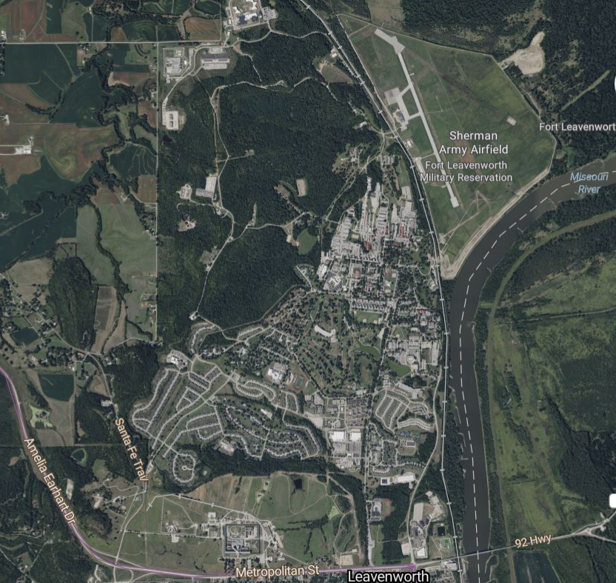
Ranger Buddy Competition Location
Sherman Army Airfield
Cadet and Cadre Barracks
Mission Training Complex
Area of Interest: Fort Leavenworth, KS is the oldest continuously operating military installation west of the Mississippi River. Fort Leavenworth is home to The US Army Combined Arms Center (CAC). Fort Leavenworth is home to all “Field Grade Officers” and runs the US Army Command and General Staff College. Fort Leavenworth is home to about 2,892 active-duty Soldiers, 1,130 students, and 5,175 APF and NAF Civilians.

Slide 7
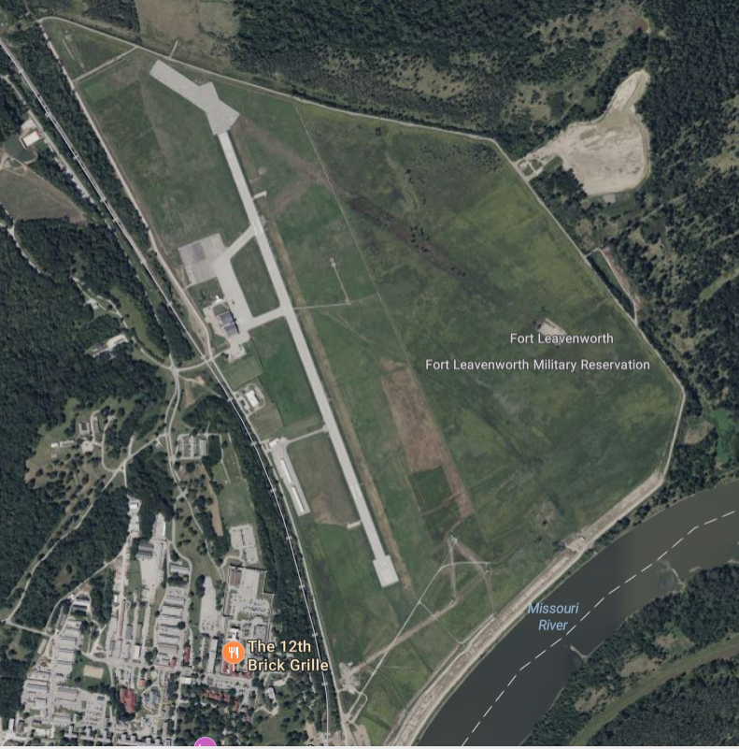
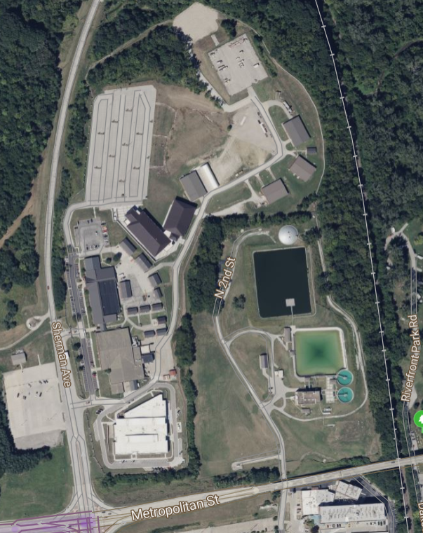
Area of Operations: Mission Training Complex. Located at the southeast corner of Fort Leavenworth, the facility offers 45,000 feet of configurable indoor training space, a DFAC, and on-site barracks that can house up to 560 Soldiers.
Sherman Army Airfield/ Chief Joseph Loop. The primary area of ops. is bounded to the South by the Missouri River, to the West by Fort Leavenworth railway, to the North by the 61 Easting, and to the East by the 37 Northing. The Chief Joseph Loop is a dirt and gravel road capable of holding single way traffic that encircles all of Sherman Army Airfield. The largest identifiable feature is the Sherman Army Airfield.

Slide 8
Mission:
3rd Brigade conducts Ranger Buddy Competition, under the direction of the University of Kansas, Jayhawk Battalion, at Fort Leavenworth, KS on 290700-1830MAR25 to instill a culture of winning and excellence across Cadet Command while maximizing the event as an ROTC marketing opportunity

Slide 9
Event Concept
Execution:
Concept of Operations. This operation is conducted in three phases. Phase I- RSOI, Phase II- Execution, Phase III- Awards Ceremony and Dismissal. Decisive to this operation is execution of warrior tasks during PH II.
Phase I-RSOI: This phase begins with the Arrival of KU Advon on 27MAR2025. Critical to this phase is the reception and in-process of all Cadets. During this phase Cadets will receive OPORD brief to prepare for competition. This phase ends when Cadets are in classrooms prepared to receive written land navigation test.
Phase II- Execution: which begins with the Cadets receiving Land Navigation written test. Decisive to this phase is the completion of the lane tasks. During this phase Cadets will complete 12 miles of Road March, written land nav, and execution of tactical lanes. This phase ends when all Cadets complete all tactical tasks and close out with holding area cadre.
Written Land Navigation: After completion of RSOI and receipt of coaches' brief, Cadets have 1 hour to complete a written land navigation examination. This exam follows CST standards.
Red Lanes: Cadets complete five tasks at stations during this sub phase and a 4-mile road march. 1. M240, 2. M249, and 3. M4, all weapons assembly, disassembly, functions check. 4. Hand grenade identification, and 5. Hand Grenade Employment.
Blue Lanes: Cadets complete five tasks at stations during this sub phase and a 4-mile road march. 1 Call for Fire, 2/3. Spot Report/ put into operation SINGARS, 4. Tie a Swiss Rappel Seat, 5. Move under direct fire.
White Lane: Cadets complete five tasks at stations during this sub phase and a 4-mile road march. 1. Perform first aid of a fracture, 2. control bleeding, 3. perform first aid to prevent and control shock, 4/ 5 Care under fire.
Road March: Competitors complete three (3) 4.5-mile-long road marches. Each road march will increase in difficulty as the event progresses.
Phase III- This phase begins when all tactical tasks are complete and ends with the awarding of the top 1,2,and 3 Ranger Buddy Male, Female, and Co-Ed team winners.
Red Lane
White Lane
Blue Lane
Road March

Slide 10
Scoring Guidelines
Score is broken into four events (Written Land Navigation, Ruck Times, Tactical Lanes) Written Land Nav 10% the competitor's total score. Ruck times are weighted at 40% of competitor's total score. Tactical lanes are weighted at 50% a competitor's score
Best Written Score
Highest Number of Go’s
Fastest Ruck Time
Best overall school is based on total points for each program.
Standings are updated between events.

Slide 11
Planning Timeline
28-29MAR25- RBC
Execution
27MAR- ADVON arrives,
Sign for barracks, day 1 prep
21MAR25-Final Checks
14MAR225- IPR #5- Final Confirmation
07MAR25- IPR #4
01MAR25- Registration closes
21FEB25- IPR #3
09MAR- All purchases made with delivery expected on 24-25MAR25
Confirm National Guard support
09FEB- All Purchase Requests due to BDE 4
Northen Warfare Challenge- 20-22FEB
07FEB25-IPR #2
24JAN25-IPR #1- Concept of Operations
20JAN25- Registration Open
08JAN25- OPORD Published/ Requests made for NG support
10DEC24- BDE Commander Back brief
07DEC24- KU RBC Planning Conference

Slide 12
Event Timeline
27 MAR 25
1200- ADVON Arrives Fort Leavenworth
1200- Sign for Barracks
1300- Latrines, Golf Carts, and Tents arrive and established
1700- Lanes established, lane rehearsal begin
2000- Lane rehearsals complete
28 MAR 25
0900- In-processing opens
1800- In-processing closed
- DFAC 1 open for competitors
- Lecture Hall 1 Coaches Brief
2000- TBD PMS and BDE Social
1930- DFAC Closed
2100- Lecture Hall 1 and 2- Written Land Nav Test
29 MAR 25
0700- Competition begins
0830- Lane internal rotation
1000- Iteration 2 (Red, White, Blue)
1130- Lane internal rotation
1300- Iteration 3 (Red, White, Blue)
1430- Lane internal rotation
1600- End of competition
1700- Awards ceremony

Slide 13
Reception Staging and Onward Integration.
Phase I- RSOI- This phase begins with the publish of the operations order.
This phase ends upon completion of the written land nav exam.
Critical to this phase is the reception of all competitors to Ft. Leavenworth.
*During this phase competitors sign up for Ranger Buddy via google
forms.
*On 28MAR25, competitors' stage at the mission training complex,
Ft. Leavenworth, KS.
* 281800MAR25, two cadets from each school in attendance receive
the coaches brief.
281900MAR25 PMS’s and 3rd BDE CMD team conduct 3rd BDE
Social
282000MAR25 every team receives a written land nav exam. Competitors have one hour to complete the exam.
Parking
Barracks
Lecture 1 and 2
DFAC 1
DFAC 2

Slide 14
Insert Map of Mission Training Complex

Slide 15
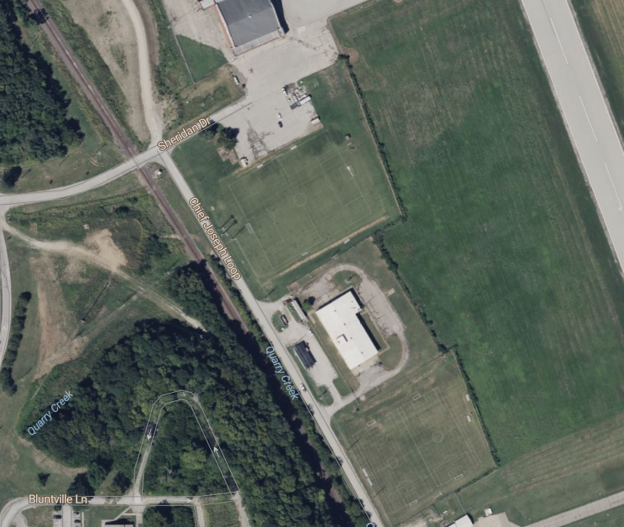
Color Lane Tasks
Red Lane Maintain M240 | White Lane Perform First Aid for a Suspected Fracture | Blue Lane Call for Fire
Maintain M4 | Control Bleeding | Knots Lane
Maintain M249 | Perform First Aid to Prevent or Control Shock | Spot Report
Identify Hand Grenades | Care under Fire | *AESIP Radio (in conjunction with SPOT Report)
Employ Hand Grenades | *Request MEDEVAC (in conjunction with Care under fire) | Move under direct fire
HA
HA
Red Lanes
Blue Lanes
Road March Start
HA
HA
White Lanes
PH II- Execution (Tactical Lanes) During this phase, Cadets divide amongst the three color lanes. Each lane will have 5 stations with up to 30 teams competing. Competitors have 1.5 hours to execute all tasks at the lanes.
Red Lanes: Cadets complete five tasks at stations during this sub phase and a 4-mile road march. 1. M240, 2. M249, and 3. M4, all weapons assembly, disassembly, functions check. 4. Hand grenade identification, and 5. Hand Grenade Employment.
Blue Lanes: Cadets complete five tasks at stations during this sub phase and a 4-mile road march. 1 Call for Fire, 2/3. Spot Report/ put into operation SINGARS, 4. Tie a Swiss Rappel Seat, 5. Move under direct fire.
White Lane: Cadets complete five tasks at stations during this sub phase and a 4-mile road march. 1. Perform first aid of a fracture, 2. control bleeding, 3. perform first aid to prevent and control shock, 4/ 5 Care under fire.
As of 07 APR 22
23
Notes:
184 total teams MAX
54 total graders for all stations

Slide 16
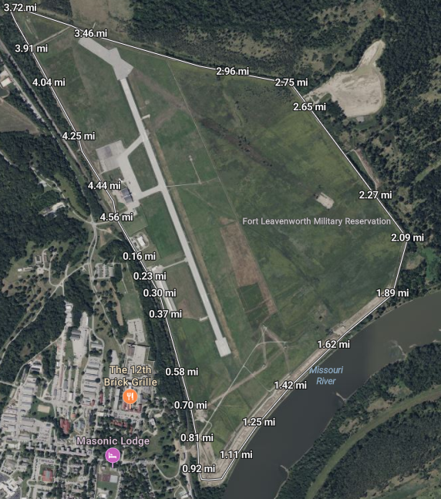
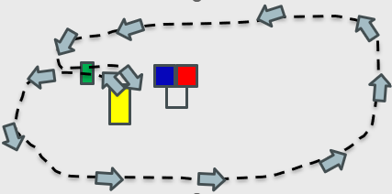
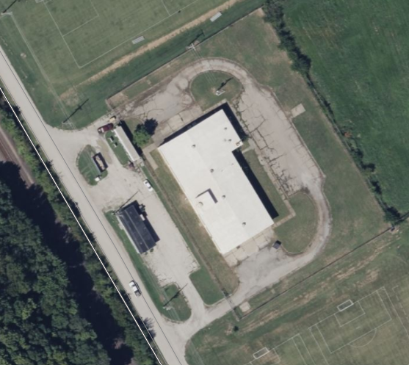
13.5-Mile Road March
PH II- Execution (Road March) This phase occurs simultaneous to the color lane tasks. During this subphase competitors complete three (3) 4.5-mile-long road marches. Each road march will increase in difficulty as the event progresses.
Event Analysis:
Weigh in occurs NLT 0630 Morning of the Competition
Competitors are divided onto three separate lanes (Red, White, Blue)
Up to 30 teams are placed at each of the three lanes.
15 teams execute the color lane tasks
15 teams execute the tactical road march
All competitors execute road march in a counterclockwise movement
Times are taken by Red Dirt Racing
All three times are consolidated and the best time wins
Each iteration competitors are tasked with carrying an item
Items increase in weigh each iteration
At the 1.5-hour mark Cadets rotate either to lane tasks or the road march
Cadets still on the course lose time to conduct color lane tasks
LRP
LRP
TF CP
Tactical Lanes
COA Sketch
Staging
Start line
Color lane staging areas
Start
Road march staging area
Road March Start Line
Sustainment:
Classes of Supply:
I: MRE (B), Boxed Meal (L)
VI: Weights (Iterations I/II Road March
Transportation:
Red Dirt Racing Timing solution for Road March
Golf Cart provided for lead and trail
Medical:
EMTs and BDE Nurse Staged at Recovery Tent
Golf Cart Dedicated to Medical Recovery
Standards:
Cadets will complete each 4.5-mile lap in the 1.5 hours provided.
Times are recorded via a timed solution.
Fastest overall course time receives the max amount of points
Command and Control:
Command:
Lane OIC- SFC Lynn (KU)

Slide 17
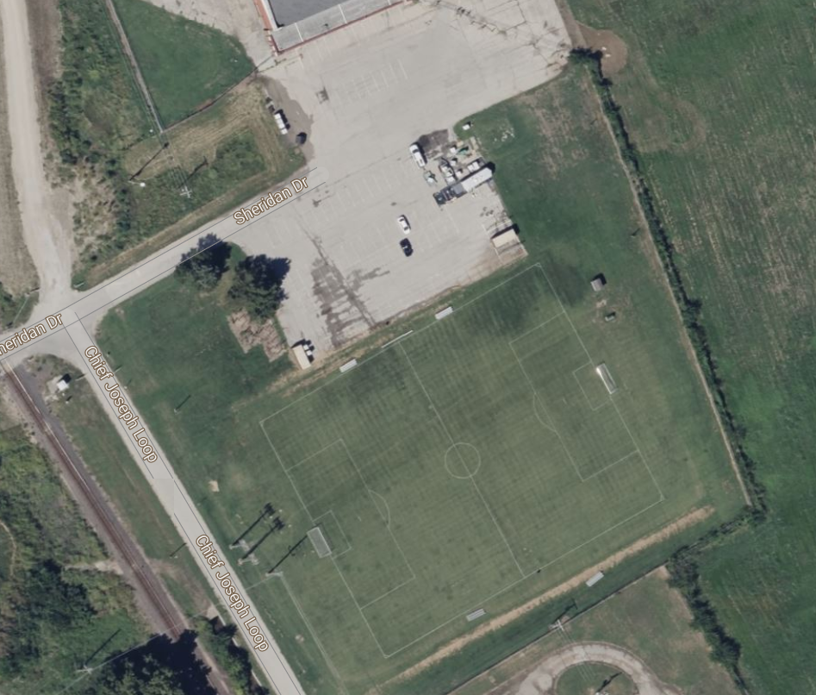
Red Lane Overview
Lane Concept- Cadets receive brief from station OIC at red lane staging area. Teams move to Road March staging or receive lane brief and travel to stations. Stations are managed by lane OIC. No more than 30 teams are executing tactical tasks at lane. Station must accommodate up to 15 teams competing and 15 teams staged at any time.
Station 1- One team member will clear and disassemble M240 in 3 minutes. The other team member will assemble, and functions check in 3 minutes.
Station 2- One team member will clear and disassemble the M4 in 2.5 minutes. The other team member will assemble, and functions check in 2.5 minutes.
Station 3- One team member will clear and disassemble M249 in 3 minutes. The other team member will assemble, and functions check in 3 minutes.
Station 4- As a team, Cadets will correctly identify six grenades by nomenclature and purpose within 2.5 minutes
Station 5- Each team member will receive four (4) grenade bodies. Each team member will have 30 seconds to defeat enemy in the open by landing one of two grenades within a 5-meter radius of target. Each team member will have 1 minute to defeat enemy in a window or bunker by getting 1 grenade through window.
Task Force CP
Latrines
Blue Lane
5
3
Direction to Road March
2
4
1
Red Lane Staging
Sustainment:
Classes of Supply:
IV: Construction Material (3x Window), (6x Barriers)
V: Grenade Bodies (30)
IX: M4 (9), M249 (9), M240 (9)
Medical:
Medics and BDE Nurse Staged at Recovery Tent
Safety:
All three teams on grenade will move forward at the same time to prevent stray grenades from striking competitors.
Red Lane | Time STD
1. Maintain M240 | 6 Min
2. Maintain M4 | 5 Min
3. Maintain M249 | 6 Min
4. Identify Hand Grenades | 2.5 Min
5. Employ Hand Grenades | 1 Min (2x) .5 Min (2x) 3 Min
Command and Control:
Command:
Lane OIC- UMKC
Notes:
2 graders and 4 stations
4 graders and 4 stations
4 graders and 4 stations
4 graders and 4 stations

Slide 18
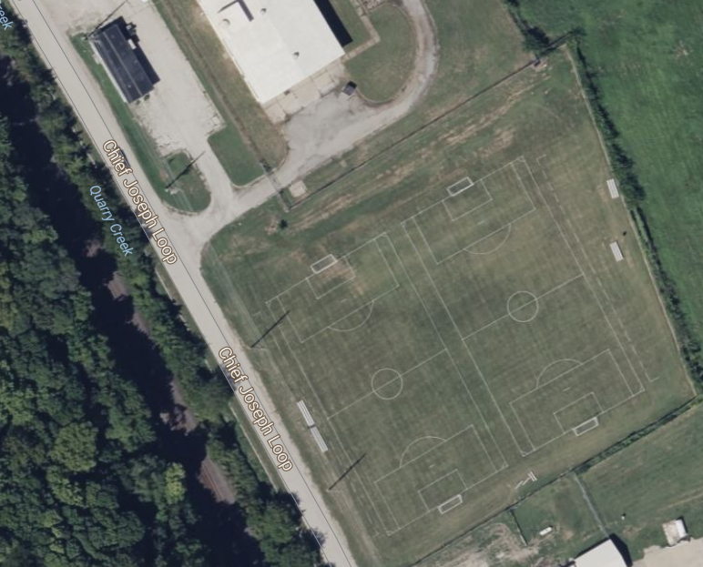
White Lane Overview
Lane Concept- Cadets receive brief from station OIC at white lane staging area. Teams move to Road March staging or receive lane brief and travel to stations. Stations are managed by lane OIC. No more than 30 teams are executing tactical tasks at lane. Station must accommodate up to 15 teams competing and 15 teams staged at any time.
Station 1-3- Cadets assess and treat casualty for Fracture, Bleeding, and Shock. Casualties are a Ranger Randy. The injuries are placed on the Ranger Randy. Cadets assess and treat all three injuries. Shock is briefed to cadets during the lane brief.
Station 4- As a team, Cadets will identify a casualty in the open. Cadets will perform all steps of care under fire, in sequence, within 3 minutes. Cadets will have 6 minutes to transport the casualty to designated HLZ without inflicting further harm on the casualty.
Station 5- Cadets request a 9 Line Medevac Request. Cadets have 3 minutes to prepare medevac. Cadets transmit lines 1-5 in 25 seconds. Cadets transmit lines 6-9 in one additional minute.
Direction to TF CP
Road March Staging
4
5
3
2
White Lane Staging
1
Sustainment:
Classes of Supply:
IV: Sandbag bunkers (18 Sandbags)
VIII: Sling (30), Tourniquet (30), Litters (3), CLS Bags (6)
IX: Ranger Randy (9)
Medical:
Medics and BDE Nurse Staged at Recovery Tent
Medic on station to assist with grading
Safety:
Water equipped on site and staged near litter carry
White Lane | Time STD
1. Perform First Aid for a Suspected Fracture | 5 Min
2. Control Bleeding | 5 Min
3. *Perform First Aid to Prevent or Control Shock | 5 Min
4.Care under Fire | 9 Min
5. *Request MEDEVAC (in conjunction with Care under fire) | 4.5 Min
Command and Control:
Command:
Lane OIC- TF Leavenworth
Notes:
2 graders and 4 stations
4 graders and 4 stations
4 graders and 4 stations
4 graders and 4 stations

Slide 19
Blue Lane Overview
Lane Concept- Cadets receive brief from station OIC at Blue lane staging area. Teams move to Road March staging or receive lane brief and travel to stations. Stations are managed by lane OIC. No more than 30 teams are executing tactical tasks at lane. Station must accommodate up to 15 teams competing and 15 teams staged at any time.
Station 1- On a terrain model, one team member identifies target in accordance with the prescribed scenario. Team member will have 3 minute to successfully transmit a request for fire. Teams will then have an additional 45 seconds (ea) to call at least two but no more than six bracketing corrections. Team has 30 seconds to complete the transmission.
Station 2- Each team member is given a 15 foot rope. Each team member has 5 minutes to correctly tie (Prusik, Bowline, Square Knot, clove hitch, figure eight retrace)
Station 3-4- Spot report and AESIP radio are done in conjunction. One team member is given a set of binoculars and the other is given a 1523- AESIP radio. One team member develops a SPOT report while the other team member puts into operation the RT 1523. Upon completion of the report, the Cadet operating the radio transmits the lines of the SPOT report.
Station 5- Cadets move from one end of the course up to 200 meters towards an enemy position where they are receiving contact. Cadets correctly bound between covered positions selecting cover that is appropriate to the situation.
Task Force CP
Latrines
3
5
1
4
2
Direction to Road March
2
Blue Lane Staging
Red Lane
4
Blue Lane | Time STD
Call for Fire | 8 Min
Knots Lane | 5 Min
Spot Report | 10 Min
*AESIP Radio (in conjunction with SPOT Report) | 5 Min
Move under direct fire | 1 Min (2x) .5 Min (2x) 3 Min
Command and Control:
Command:
Lane OIC- KSU
Sustainment:
Classes of Supply:
III: C02 Canisters (paintball guns)
IV: Construction Material (6x Barriers), (18x Sandbags), (15x 15-foot rappel ropes)
IX: 3x Pneumatic sound machine or paintball gun with C02. (5x AESIP radios), (4x M22 binoculars)
Medical:
Medics and BDE Nurse Staged at Recovery Tent
Safety:
Teams will have appropriate safety gear while executing the movement under direct fire lane. No paintballs are use. Paintball markers only used for noise creation.
Notes:
2 graders and 4 stations
4 graders and 4 stations
4 graders and 4 stations
4 graders and 4 stations

Slide 20
Phase III Awards Ceremony
Awards Concept- Upon completion of the final lane, Cadets consolidate near the red and blue lanes. NLT 1800 Cadets receive brief from Blackhawk 6 and are recognized on the podium.
Awards- 1st Place – Male, Female, and Co-ed teams
2nd Place – Male, Female, and Co-ed teams
3rd Place- Male, Female, and Co-ed teams
Best Battalion- school having the top scores of all eligible competitors
Awards Podium
Formations
Sustainment:
Classes of Supply:
IV: Podium
VI: 18 Plagues (1st, 2nd, 3rd for each category), 10x streamers (1st , 2nd, 3rd, and best bn), 1 x trophy (best bn)
Medical:
Medics and BDE Nurse Staged at Recovery Tent
Command and Control:
Command:
Lane OIC- LTC Taetzsch (KU)
VIP- COL Cruz (Pending)
Materials Needed:
2x Gators/ vans (medical support)
6x Handheld Radios
10x Water cans
3x fuel cans (gator)
Distance: 5K
Time Standard: 30 MIN

Slide 21
Concept of Sustainment
Class I:
Class VI:
 | 27MAR25 | 28MAR25 | 29MAR25
Breakfast | N/A | MRE (25) | MRE (510) Fruit and Protein (500)
Lunch | N/A | Boxed Lunch (TF Support) | MRE (510) Boxed Lunch (TF Support)
Dinner | Dinner Local Restaurant (25 ADVON) | Competition dinner catered (510) BDE Social catered (45) | Boxed to go Dinner (510)
 | Material | Justification | Cost
Teams | Patches 500 Competitor Patches | Competitor Identification
Road March | 10 heavy duty fish scales | Ruck weigh in
Lanes | T/C/S signs (15) | Lane T/C/S
Posters | Ranger Buddy Poster (3) | Mark event
Trash | Trash Cans (10) | Trash Disposal
Trophies | BN Trophy, 3 first place | Award winners
Streamers | 1st, 2nd, 3rd, bn (10) | Awards
Class IV:
Lane | Material | Justification | Cost
Blue | 4x8 Plywood | Low Wall (X3)
White | 4x8 Plywood | Low wall (X3)
Red | 4x 8 Plywood | Low wall x6, window wall (x3)
Awards | 4x 8 Podium | Podium
All | Sandbags | Sandbags for lanes (40)
Class IX:
 | Material | Justification | Cost
Race Solution | Timing Solution- Manhattan Running | Track competition
Tents | Medical tents (2) | Treat casualties store food
Golf Carts | Race support Carts (6) | Manage Road March
Latrines | Portable latrines and hand washing | relief

Slide 22
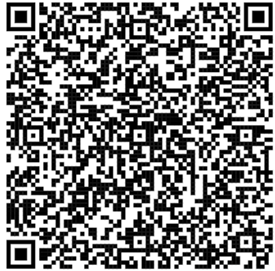
Transportation
Phase I:
Cadre from competitors' university drop competitors at Mission Training Complex and park in the designated parking area.
Parking
Location of MTC:

Slide 23
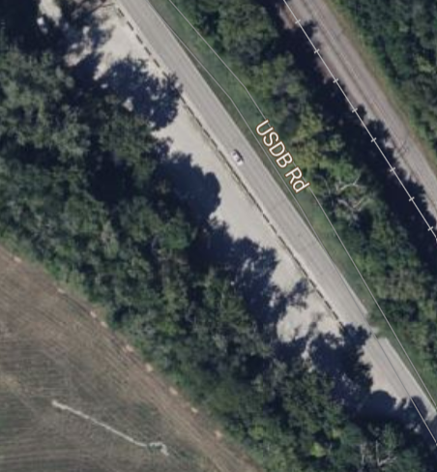
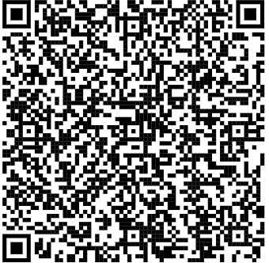
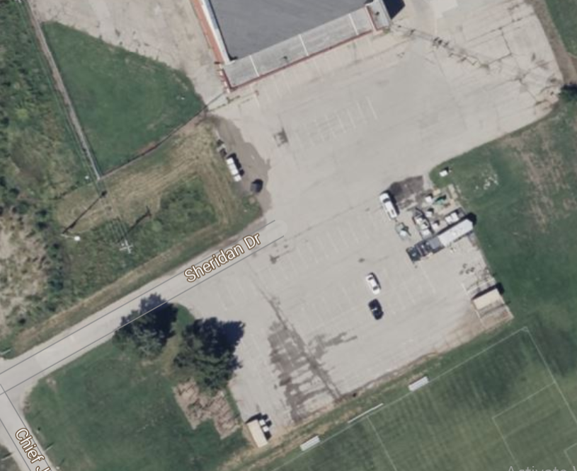
Transportation
Phase II: Cadre bring competitors via GSA to the Cadet Drop off NLT 290530MAR25. 2.9 Miles.
Road March- three dedicated golf carts assist with road march. Lead vehicle, trail vehicle, and resupply vehicle.
Tactical Lanes- one golf cart is assigned to resupply tactical lanes
Cadre Parking= 892 Meters
Location of drop off:
Cadet drop off= 2.9 miles

Slide 24
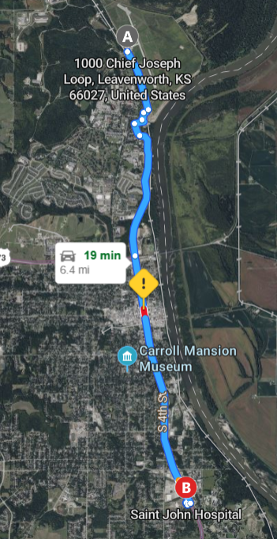
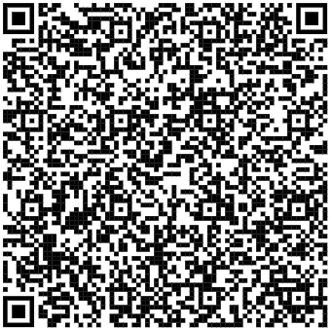
Medical
Command and Control:
CPT Williams leads all operations for medical evacuation
Priority of Care:
Urgent- Immediate 911 Call
Priority- Evac to Aid station and transport via GSA to Saint Johns. 6.4 miles.
Routine- Treated at aid station.
Personnel:
5x Medics from National Guard
BDE Nurse- CPT Williams
Equipment:
Dedicated Golf Cart
Dedicated GSA
Location of Saint Johns:

Slide 25
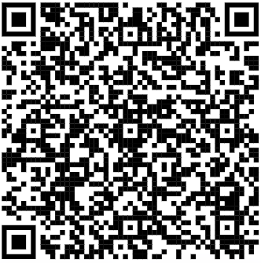
Command and Control
Internal Lane Control:
Handheld Radios
Command Post 1-1
Road March 2-1
External Communication:
Signal Chats:
Event Standings – TBP
RFI Chat
Process for Lane disputes:
Cadet to station OIC > Lane OIC > CP OIC > PMS of KU
Process for score keeping:
Scored at station (hole punch) > Lane OIC > Golf Carts > Command Post

