Slide 1
Ranger Buddy Competition 2023
Lawrence, Kansas ANNEX C
1
Notes:
1

Slide 2
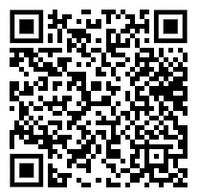
Event Registration
Registration for Ranger Buddy Competition opens: 12 January 2023
Registration for Ranger Buddy Competition closes: 03 1700 April 2023
Registration restrictions:
3rd Brigade: 3 Male Teams, 2 Female Teams, and 2 Co-ed Teams
Other Brigades: 1 Male Teams, 1 Female Team, and 1 Co-ed Team
Ranger Buddy Competition - Google Forms
5

Slide 3
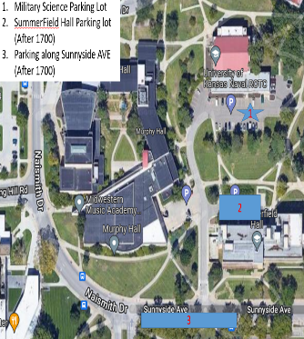
RSOI / In-Processing
ADMIN
ROO Office
LATRINE
MSB Entrance
MSB Exit
CADET LEADER OFFICE
ROO Storage
LOUNGE
Small Classroom
Ops Office
Check-In Tables
SUPPLY
COPIER
Big Classroom
HRA
PMS
SMI
Notes:
- Team receives welcome packet (score card, numbers, chip timer). Do not lose these items.
- KU Cadre at Armory directing traffic for sleeping arrangement.
As of 06 APR 22
7

Slide 4
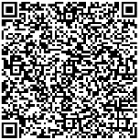
Final Billeting Plan
Lodging: | Schools | Cadets
Armory
Address:
National Guard Armory: 200 Iowa St, Lawrence, KS 66046
Notes:
For those staying at the NG Armory – you must clear with KU BEFORE departing the Armory. Failure to clear may result in DQ. KU Representative will be at the Armory starting at 080415APR23.
KU Representative will lock the Armory NLT 080900APR23 and will not return until 1700.
If you are staying until 9APR23. You must be clear of the Armory NLT 090900APR23.
KU Representative for Armory POC: 913-775-1847
Driving Directions
As of 09 APR 21
8
Notes:
Mizzou

Slide 5
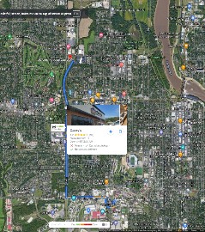
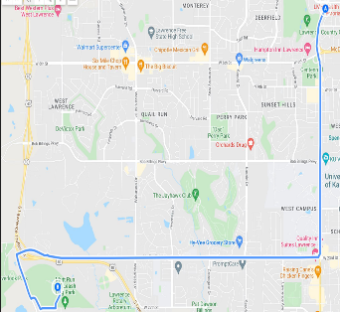
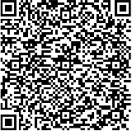
MAPS and DIRECTIONS
MSB to National Guard Armory
About a 7 minute drive
Armory to Sesquicentennial Point
About a 15 minute drive
-Turn Right onto Sunnyside Ave
-Turn Left onto W 15th St
-Turn Right onto Iowa St
-Go under 6th Ave overpass
-Continue on McDonald Dr
-Turn Left on W 2nd St
Area highlighted in next slide
- Head Southwest on McDonald Dr. toward W 4th St.
Keep left to continue toward Iowa Street
Slight Right onto Iowa St. pass by Commerce Bank (on the right in .4mi)
Turn Right onto Clinton Parkway
At the traffic circle, continue straight onto N 1400 rd/ Clinton Parkway continue to follow Clinton Parkway.
Turn left onto E 900th Rd
Turn left onto E 902 RD
Turn left
Addresses:
MSB: 1520 Summerfield Hall Dr, Lawrence, KS 66045
Sesquicentennial Point (in google maps) or Follow QR Code
*NOTE: this takes you to the TOC
National Guard Armory: 200 Iowa St, Lawrence, KS 66046
As of 06 APR 22
9

Slide 6
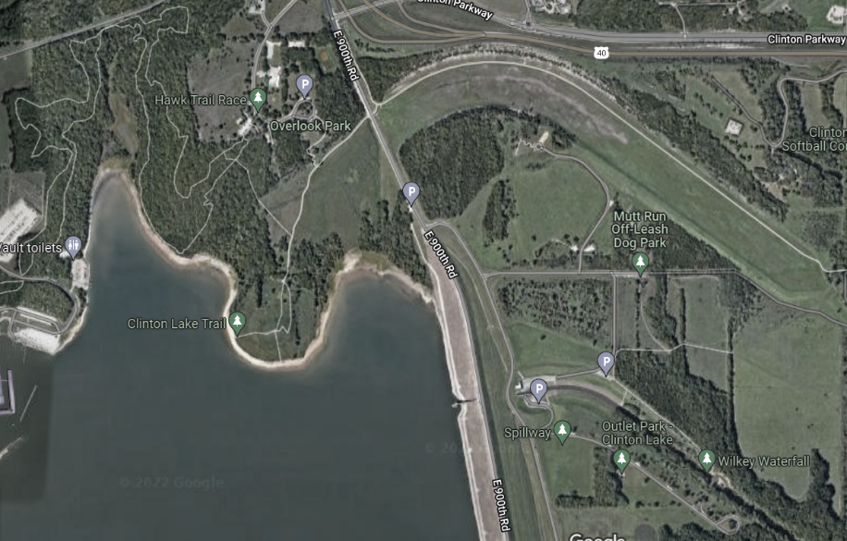
Map of Sesquicentennial Point Park
N
KEY
X-Mile Ruck Route
Blue Lane
White Lane
Red Lane
5 km Run Route
TOC/ VIP Parking
Competition Parking
RBC PARKING
Area highlighted in next slide
As of 06 APR 22
10

Slide 7
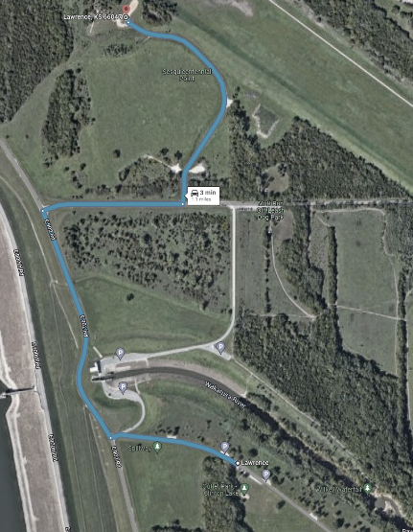
PARKING AND COMPETITOR DROP-OFF
Parking for the event is at the OUTLET PARK on the SOUTH SIDE of the spillway (also present in google maps). You can park anywhere along this road, but there are pull in spots AT OUTLET PARK.
NOTE: It is about ONE MILE from the parking to the TOC/START so recommend teams drop your competitors off, then park. Alternately, teams can park and add a few miles to their total by walking up.
DO NOT park at the Mutt Run Off Leash Dog Park or on the north side of the spillway.
PARKING
As of 06 APR 22
11

Slide 8
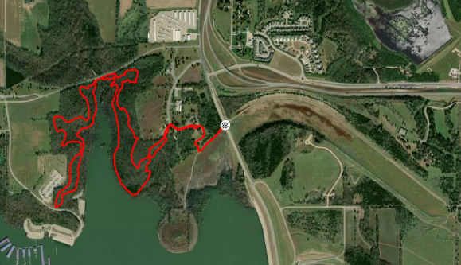
Event Concept
Concept of Operations. This operation is conducted in five phases. Phase I- Planning and Preparation, Phase II- X Mile foot march, Phase III-Tactical Lanes, Phase IV- 5K Buddy Run, Phase V- Award Ceremony, Recovery, and Release. Decisive to this operation is execution of tasks during Phase III, Tactical Lanes. Tactical lanes are decisive because these operations are the most resource intensive and require the most staff to execute.
15k/5k End Point ---
15K Route ---------
5K Route ------------
Red Lane ------------
Blue Lane -----------
White Lane ---------
Phase I-Planning and Preparation. Critical resourcing will occur in Phase I prior to 03MAR23. On 03MAR23, KU hosts the final resource meeting via MS Teams.
Phase II- X Mile Foot March which begins with the establishment of the foot march course on 080500APR23. During this phase, Cadets travel between 9-12 miles.
Phase III- Tactical Lanes Includes execution of three tactical lanes. These lanes include 15 basic Soldier tasks and battle drills.
Phase IV-5 K Buddy Run. This phase occurs when time elapses on the Tactical Lanes. Cadets complete the 5K buddy run while remaining within 5 Meters of their partner.
Phase V- Award Ceremony, Recovery, Release. This operation occurs upon completion of the final team crossing the finish line to the 5K. This phase occurs at 081800APR23.

Slide 9
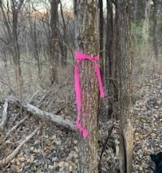
X-Mile Road March
Start Point
Popsicle point
Phase 2 X-Mile Foot March: This phase begins at 080430APR23 with the establishment of the TF CP at Sesquicentennial Point. NLT 080500APR23 all checkpoints report establishment. Female and coed teams start X-mile NLT 080600APR23. Male teams start X-mile NLT 080930APR23. Teams must get their rucksack weighed prior to the start of the x-mile event. Weights are taken at the TF CP one and a half to a half hour prior to the event. The route begins at Sesquicentennial Point and traverse across Clinton Lake State Park. There are four waterpoints along the course. Road guards are placed at E 900th Road. Participants exercise caution while traveling along roads as some traffic may exist. There are three medics assisting during the road march. One at the CP, one at the turn around, and one in a trail vehicle. This phase ends when the final team completes the road march and returned to the CP. This phase overlaps with the next phase.
Follow the pink ribbons (about every 25m)
White diamonds out blue diamonds back
Popsicle Point
If injured call someone on contact roster or make it to CP.
Command Post
Checkpoint
Signage
Water point
Medical Pax/vic

Slide 10
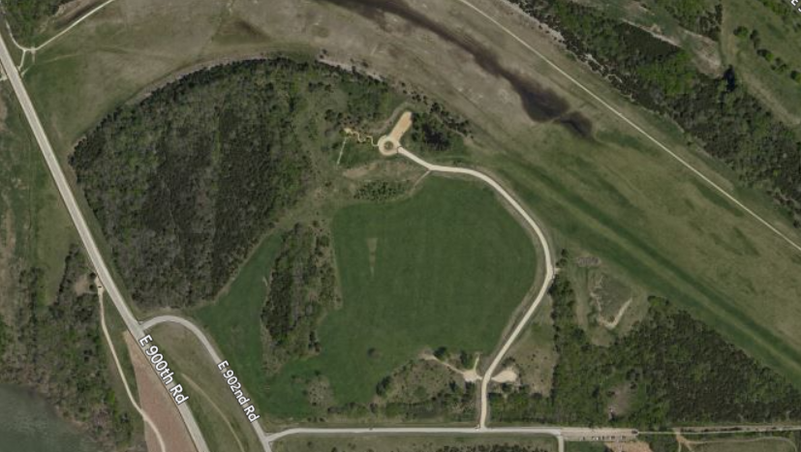
Color Lane Tasks
Red Lane Spot Report and *AESIP Radio | White Lane Perform First Aid for a Suspected Fracture | Blue Lane Identify Topographic Symbols on a Military Map
Maintain M4 | Control Bleeding | Range Card
Maintain M249 | Perform First Aid to Prevent or Control Shock | Identify and Employ Hand Grenades
Maintain M240 | * Litter Carry | Protect yourself from CBRN attack
* Ammo Can Carry | Request MEDEVAC | * CBRN Supply Run
PH III- Tactical Lanes
This phase begins 08 0700 APR 22 with the establishment of the three tactical lanes. Critical to this phase is completion of as many tactical tasks as possible within the allotted time. Each team receives two attempts at any single task. If a team is unsuccessful after two attempts, the team will be told to continue to the next task and receive a no-go for that task. During this phase, cadets move to any of the three colored lane start points and begin completing the tasks. Red lanes consist of SPOT report which is performed using binoculars and RT 1523 AESIP radio in a tactical scenario. Additionally, Cadets test on assembly and disassembly of M4, M249, M240. Last, Cadets complete the Ammo Can Carry. White lane consists of first aid of a fracture, control bleeding, prevent shock, casualty evacuation carries, and requesting MEDEVAC using a RT 1523 AESIP radio. Blue Lane consists of range card, navigation symbols and graphics, identify and employ hand grenades, protect yourself from CBRN attack, and CBRN supply carry. All three lanes occur IVO Sesquicentennial PointThis phase ends when time expires. Time allotted for each of the teams are 6 hours for the female teams, 5.5 hours for Co-ed teams, and 4.5 hours for the male teams. The time for these lanes begins 1 hour after the start of the road march. The team with the most correctly performed tasks is the winner of this event. Ties are decided by time and then the least number of events attempted twice.
* Not in USAIS PAM 350-6
Avoid the start/ finish until ready for 5K
As of 07 APR 22
23
Notes:
184 total teams MAX
54 total graders for all stations

Slide 11
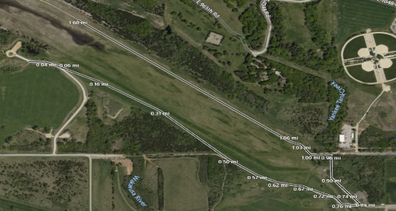
5K Buddy Run
PH IV- 5K Buddy Run
This phase begins with the completion of the tactical lane's completion by the Female or Coed Team. Critical to this phase is the completion of the run by all three categories of teams. Reference ANNEX C. Two medics support this event. One is located at the CP; the other is positioned at the turn around point or 1.5 miles into the run. Each team must complete a mystery event before completing the 5K run. Failure to complete the mystery event results in disqualification of a team. The mystery event is announced during the coaches meeting. This phase ends when all teams cross the finish line near the CP and times are recorded.
Deposit your chip timers into the bins
Timers must be worn outside of pants
Command Post
Checkpoint
Signage
Water point
Medical Pax/vic
Mystery event

Slide 12
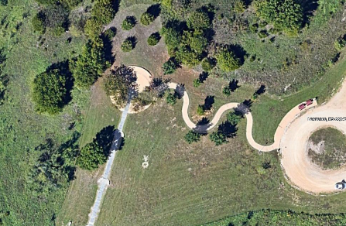
RBC Awards Ceremony
Mission:
Brigade Leadership with KU ROTC Cadre perform awards ceremony for top three teams in each event along with best battalion.
Intent:
Recognize outstanding cadets who displayed competence, resilience and physical fitness.
AWARDS AREA
End state:
Upon completion of Ranger Buddy Challenge the top three teams from the three divisions will be recognized in front of their peers. Best Battalion will be last.
Audience
Timeline
08 April 23
1530: MSG Geery conducts final setup
1545: Co-ed and women’s teams notified and on stand by
1600: Final Conditions check
1605: Men’s teams notified and on stand by
NLT 1630: Awards ceremony begins with comments from BDE CDR,
1645: Awards ceremony complete
(Time is flexible based off of competition completion.)
TOC
Concept of the Operation
The Brigade Commander and CSM address all remaining competitors at the start of the ceremony; SMA(ret) may address cadets. Once speakers are complete, we will recognize competitors in the following order. 3, 2, 1st co-ed, 3, 2, 1st female team, 3, 2 1st male team. We will then recognize the top battalion. Competitors will be called up from the left (NW) by team to be recognized by the Brigade Commander, CSM, SMA, KU PMS and SMSI. Once the team has been awarded their streamers and plaques/trophies they will take a picture with the Brigade Command Team. They will depart to the right (SE). For Top Battalion, all of that Battalion’s cadets and cadre will come forward to receive their Trophy. *NOTE: Schools who do not have teams that are competing for placings may depart before the awards ceremony. We ask that cadre from these schools check in with TOC personnel to let us know they are departing.
Sustainment
Equipment:
Table with KU Table cloth
3 Team Trophies
3 each 1st, 2nd, 3rd place streamers
9 Individual plaques
BN TOP Trophy/ Streamer
Sound speakers with microphone
OIC: CPT Emery
NCOIC: MSG Geery
C/OIC: Cadet Nolan
28

Slide 13
Packing List
Worn/carried:
OCP top/ bottom (duty uniform)
Patrol Cap (Cover)
Boots
Eye protection
Gloves
FLC- (2x 1 QT Canteens)
Rubber Duck
Ruck Sack
Pen, Pencil, Paper
Rucksack: Must weigh 35 pounds excluding drinking water.
Rucksack will be worn during 15K Ruck March.
Cadets will not wear rucksacks on tactical colored lanes or on the 5K
Competitors must carry their own equipment.
Teams are disqualified if caught carrying their teammate’s equipment or out of prescribed uniform.
Rucksacks are inspected randomly following completion of the 15K. Teams who do not have the appropriate weight will receive a No-go for the Ruck March.
Running Shoes: May be worn to complete the 5K run.

