Slide 1
Red Lane Task 1
(SPOTREP)
Task:
171-300-0063- Operate the SINGARS ASIP Radio
171-COM-4080- Send a Spot Report
Assemble and load frequency (SC/ PT) into a tactical man packable radio for Line of Sight (LOS) voice communications, then conduct LOS radio check. Use this radio to transmit your Spot Report (SPOTREP)
Conditions:
During daylight, the Candidate is given a SINGARS ASIP Radio in a Non-CBRNE environment. The candidate is placed in an Observation Post (OP) and witnesses enemy operations. Intelligence reporting gives you the size of your target (Grader states height or width of target, ensuring Candidate identifies it).
Standards:
1. Assemble, load, and program the radio and conduct LOS radio check within 5 minutes. Correctly transmit a SPOTREP in sequence, using proper radiotelephone (RTO) pronunciation and procedures within 10 minutes.

Slide 2
Red Lane Task 1
(SPOTREP)
Line 1- Date time group (DTG) of report submission
Line 2- Reporting Unit (University-Team#) and method of observation (Unaided, Binoculars, etc.)
Line 3- Size of detected element
1. Persons (Military/Civilian)
2. Vehicles (Military/ Civilian)
3. Equipment (Military/ Civilian)
Line 4- Activity of detected element at DTG of report (sub-type if applicable) If needed add narrative.
1. Attacking (direction from) I. Air defense artillery II. Aircraft (rotary or fixed wing) III. Ambush (IED, Sniper, anti-armor, other) IV. Indirect fire (point of impact, point of origin)
2. Defending (direction from)
3. Moving (direction from)
4. Stationary
5. Cache
6. Civilian (Criminal acts, unrest, infrastructure damage)
7. Personnel recovery (isolating event, observed signal)
Line 5- Location (MGRS) Must send correct, complete six-digit grid
Line 6- Unit (detected element unit, organization, or facility) If it cannot be identified it should be described in detail to include uniform, vehicle markings, or other identifying information.
1. Conventional
2. Irregular
3. Coalition
4. Host Nation
5. Nongovernmental organization (NGO)
6. Civilian
7 Facility
Line 7- Time (DTG of observation)
Line 8- Equipment element observed. Narrative can be added to clarify/ describe/ explain the equipment. If equipment cannot be identified, it should be described in as much detail as possible.
1. ADA (Missile (Man-portable, other, gun)
2. Artillery (gun, self propelled, towed, missile, mortar)
3. Armored track vehicle (tank, personnel carrier, command and control, engineer, transport)
4. Armored wheel vehicle (gun, apc, c2, engineer, transport)
5. wheel vehicle
6 infantry weapon (anti-armor, RPG, machine gun, etc.)
7. Aircraft (fixed-rotary wing, UAS, transport, attack, etc.)
8. Mine/IED (buried, surface, vehicle-borne IED, person-borne IED)
9. CBRN
10. supplies (Classes of supply)
11. Civilian
Line 9- Assessment (reason for/ purpose of activity and threats to/ opportunities for friendly forces)
Line 10- Narrative (actions taken related to activity: attack-withdraw-observe-other)
Potential for subsequent reports: Air support-BDA-Call for fire-EOD-etc.
Line 11- authentication (report authentication) (Initials of the reporter)

Slide 3
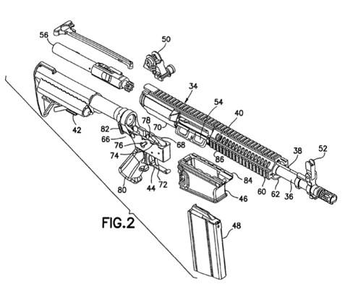
Red Lane Task 2
(M4/M16)
Task:
071-100-0032 Maintain an M16-Series Rifle/M4-Series Rifle Carbine
071-100-0029 Perform a function check on an M16-Series Rifle/M4-Series Rifle Carbine
Conditions:
Given an M4-Series Carbine, correctly clear, disassemble, assemble, and perform a function check.
Standards:
Clear (In Sequence) and disassemble the M16-Series Rifle/M4 Series Carbine in 2 minutes and 30 seconds.
Assemble the M16-Series Rifle/M4-Series Carbine and perform a function check (In Sequence) in 2 minutes and 30 seconds.

Slide 4
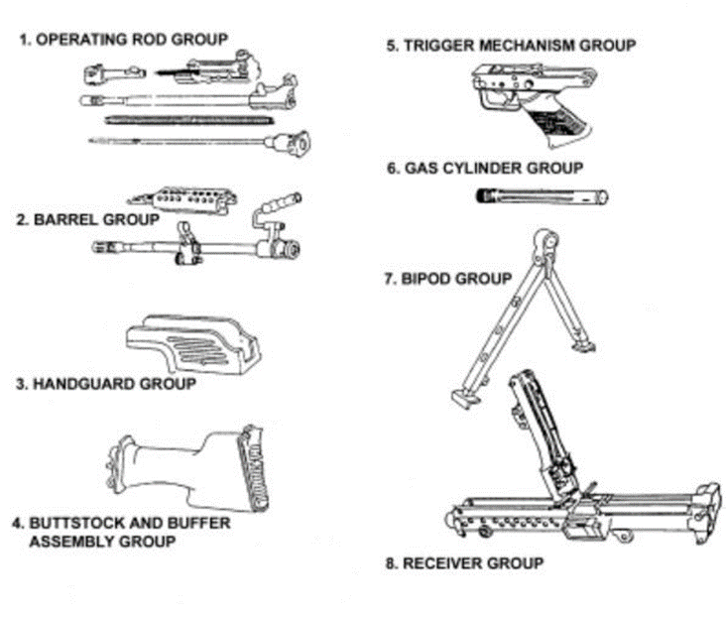
Red Lane Task 3
(M249)
Task:
071-COM-4025 Maintain an M249 Machine Gun / 071-COM-4026 Perform a Function Check on an M249 Machine Gun
Conditions:
Given an M249-Series Machine Gun, correctly clear, disassemble, assemble, and perform a function check.
Standards:
Correctly clear (In Sequence) and disassemble the M249 Machine Gun into its eight major groups (if no hand guard is present place into seven major groups) and components in three minutes.
Correctly assemble the M249 Machine Gun and perform a function check (In Sequence) in three minutes.

Slide 5
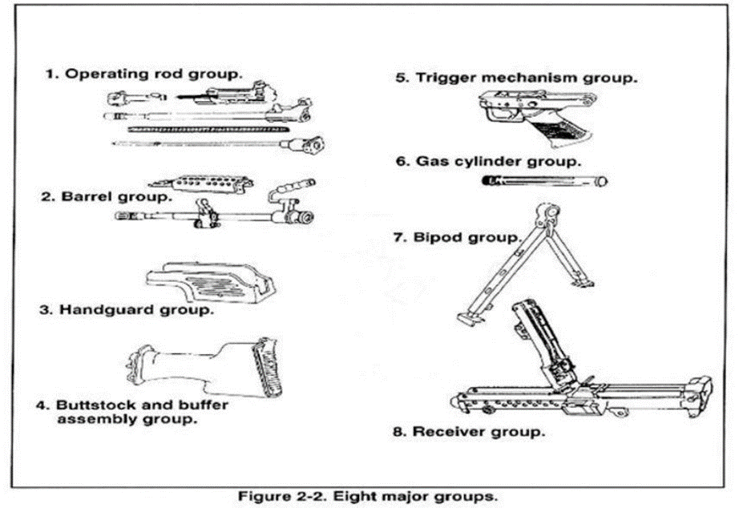
Red Lane Task 4
(M240)
Task:
071-025-0001 Maintain an M240B Machine Gun 072-025-0002 Perform a Function Check on an M240B Machine Gun
Conditions:
Given an M240-Series Machine Gun, correctly clear, disassemble, assemble, and perform a function check.
Standards:
Correctly clear (In Sequence) and disassemble the M240 Machine Gun into its eight major groups (if no hand guard is present place into seven major groups) and components in three minutes.
Correctly assemble the M240 Machine Gun and perform a function check (In Sequence) in three minutes.

Slide 6
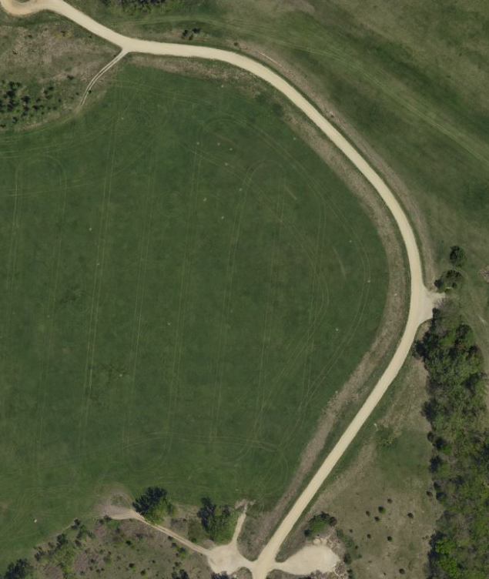
Ammo Can Carry
Task: Move four (4) kettlebells from start point at cone 1,
around the left side of cones 2 and 3, and then return on the
right sides of cone 3 then 2, and then return back to cone 1.
Condition: given, your battle buddy and four 20lb ammo cans
and the designated course.
Standard: you and your battle buddy will move from start point
at cone 1, around the left side of cones 2 and 3, and then return
on the right sides of cone 3 then 2, and then return back to
cone 1. You and your partner must complete the event in
under 3 minutes.
3
2
1

Slide 7
White Lane Task 1
(M5: Control Bleeding)
Based on:
081-COM-1001: Evaluate a Casualty
081-COM-1048: Apply a Tourniquet to Control Extremity Bleeding
081-COM-0099: Apply a Hemostatic Dressing
081-COM-1054-Apply an Emergency Bandage
Task: Evaluate a casualty using Tactical Field Care and control bleeding.
Conditions: You are a member of a team on a combat patrol that has come under small arms fire. You witness a teammate in the open receive a gunshot wound to the left leg. Your teammate was able to apply his/her own Tourniquet, move to you, and is responsive. You are behind cover, not under hostile fire, and security has been established. You have a Combat Lifesaver (CLS) bag and are not in a CNRNE environment.
Standards: (5 Minutes) Perform all tasks to standard, in sequence, within five minutes, without causing further injury.
Primary Steps (study sub steps):
Perform a blood sweep of the extremities, neck, armpits, and groin areas. Expose wounds if bleeding is detected.
Reassess any tourniquets placed during Care under Fire to ensure they are still effective.
Apply a hemostatic dressing to the major non-arterial wound that is bleeding heavily.

Slide 8
White Lane Task 2
(M10: Treat a Fracture and a Burn)
Based on:
081-831-1034-Perform First Aid for a Suspected Fracture
081-COM-1007-Peform Casualty Burn Care
Task: Perform first aid for a fracture and a burn
Conditions: You are a member of a team on a combat patrol. You witness an Improvised Explosive Device (IED) throw several teammates to the ground. You are assisting medics with triage and treatment. You are behind cover, not under hostile fire, and security has been established. The medic directed you to treat the casualty’s right leg closed fracture and burn to the left arm. You have a Combat Lifesaver (CLS) bag, are not in a CBRNE environment, and the conscious casualty is sitting up.
Standards: (5 Minutes) Perform all tasks to standard, in sequence, within five minutes, without causing further injury.
Primary Steps (study sub steps):
Reassure casualty and explain the process of treating the fracture, loosen tight/binding clothing, and remove jewelry from limb, placing in casualty’s pocket.
Check for signs of circulation problems below injury.
Splint-improvised or SAM splint.
Sling. (Not applicable for scenario above).
Swathe. (Not applicable for scenario above).
Treat burn

Slide 9
White Lane Task 3
(M6: Evaluate and Treat a Casualty for Spinal Injury and Shock)
Based on:
081-COM-1001-Evaluate a Casualty
081-000-0083-Apply a Cervical Collar (not applicable for below scenario)
081-68C-1005-Apply Preventative Measures to Control Shock
081-COM-0013-Record Treatment on a Tactical Combat Casualty Card DD 1380 (not applicable for below scenario)
Task: Identify the signs and symptoms of shock. Evaluate and treat a casualty for spinal injury and shock (cervical collar already applied)
Conditions: You are a member of a platoon within a secure Forward Operating Base (FOB) in a non-CBRNE environment. You witness a soldier fall from a guard tower that the casualty was initially fine, but complaining of nausea, difficulty breating, and abdominal pain but now only reacts to pain. The casualty is laying on a litter with long spine board with cervical collar already applied and there is another soldier available to assist.
Standards: (3 Minutes) Identify at least 6 signs and symptoms of shock with no incorrect answers within first minute.
Primary Steps (study sub steps):
Identify signs and symptoms of shock.
Apply a cervical collar. (Not applicable for scenario above).
Assess for shock.
Treat for hemorrhagic shock.
Remove DD Form 1380 from IFAK and record all treatments. (Not applicable for RBC lane)

Slide 10
White Lane Task 4
(Mystery Event Transport a Casualty)
Task: Transport a 165 lb litter under a wall, over a wall, under barbed wire, and through a window.
Conditions:
Given a 2 person team, 1 litter with 180 lbs of bumper plates, one under wall, one over wall, one barbwire course with pickets, and one window.
Standards: (10 Minutes) Traverse through the obstacle course carrying the litter ensuring you do not:
Drop the litter
Let any portion of the casualty (weights) fall off

Slide 11
White Lane Task 5
(M10: Request Medical Evacuation)
Based on:
081-COM-0101-Request medical evacuation (MEDEVAC).
Task: Request a Medical Evacuation (MEDEVAC).
Conditions:
You are a member of a team who has been directed to request MEDEVAC for a wounded teammate. You are in a wartime, non-CBRNE environment. NOTE: Give the candidate the security of the pickup site and any additional guidance.
Standards: (3 Minutes) Prepare to send the MEDEVAC within three minutes. Candidate does not need to change to a MEDEVAC frequency because ASIPs will not be used for competition (speak to the grader using radio etiquette). Transmit lines 1-5 within 25 seconds of initial contact with evacuation unit. Transmit lines 6-9 within one additional minute. All tasks will be performed in sequence, using the proper brevity codes and radiotelephone pronunciation and procedures with 100% accuracy.
Prepare the MEDEVAC request
Transmit lines 1-5
Transmit lines 6-9

Slide 12
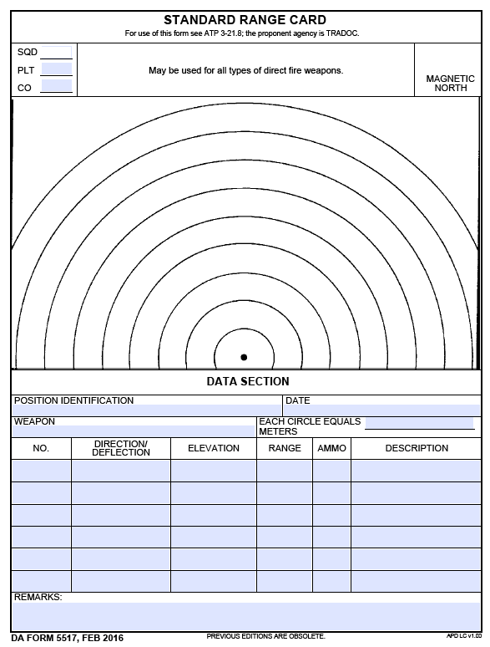
Blue Lane Task 1
(Range Card)
Based on:
071-000-0008 Prepare a Range Card for a Machine Gun
071-326-0512 Estimate Range
TC 2-21.75
Task: Prepare a range card for a machine gun
Conditions:
You are a member of a platoon gun team at a defensive fighting position in a non-CBRNE environment. You have a tripod-mounted machine gun with a traversing and elevation (T&E) mechanism. Grader will then identify the primary sector of fire with recognizable targets (either a Final Protective Line [FPL] or Principal Direction of Fire [PDF]) and the secondary sector of fire with recognizable targets.
Standards:
Complete the marginal information. Sketch the primary sector of fire, develop the sketch for the primary sector of fire, record the weapon system data, and record the position of the weapon system. All direction/deflections must be accurate within 54 mils, all ranges with no more than a 20% margin of error. Correctly perform all tasks within 10 minutes.

Slide 13
Blue Lane Task 2
(Resection and Military Maps)
Based on:
071-COM-1015- Locate an Unknown Point on a Map and on the Ground by Resection
071-COM-1000 Identify Topographic Symbols on a Military Map
071-COM-1001- Identify Terrain Features on a Map
Task: Determine you location. Identify terrain features, colors, and contour lines. Identify topographic symbols.
Condition: You are a member of a team conducting tactical operations and have a requirement to determine your current location.
Standard: Determine the correct six-digit grid to your location including using either the map and compass method or the straight edge method of resection within five minutes. Identify five major, three minor, and two supplementary terrain features, what the six basic colors represent, and the three types of contour lines within five minutes with 100% accuracy. Correctly identify 10 topographic symbols. Correctly perform all tasks within 10 minutes.

Slide 14
Blue Lane Task 3
(Hand Grenades)
Based on: 071-440-0031 Employ Hand Grenades during an Urban Operation
Task: Identify Hand Grenades
Conditions: You are a member of a team that is conducting operations in an urban environment. You have been directed to employ hand grenades against a variety of enemy targets.
Standard: Correctly identify the name/nomenclature of each hand grenade (image), within two 2 minutes and 30 seconds
Based on: 071-COM-4407 Employ Hand Grenades
Task: Employ Hand Grenades
Conditions: You are a member of a team that has been directed to employ hand grenades against troops in the open. You have two M67 Fragmentation Grenades.
Standard: Correctly perform all tasks, in sequence, within 30 seconds. One of the two grenades must come to a stop within five meters of the target.

Slide 15
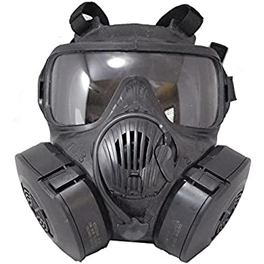
Blue Lane Task 4
(Protect yourself from a CBRN attack)
Based on: 031-COM-1004 Protect Yourself from Chemical and Biological Contamination Using Your Assigned Protective Mask
Task: Assume Mission Oriented Protective Posture (MOPP) level three.
Condition: You are a member of a platoon within a secure Forward Operating Base (FOB). You are in MOPP Level two (Notional JSLIST worn) when you suspect a chemical/biological attack.
Standard: Don, clear, and seal your assigned protective mask within 9 seconds.

Slide 16
Blue Lane Task 4
(Protect yourself from a CBRN attack)
Don Mask Assembly:
Stop breathing and close eyes (NINE SECONDS TIME STANDARD STARTS)
Remove helmet, put helmet between legs above knees or hold rifle between legs and place helmet on muzzle. (Note: if helmet falls continue to mask)
Take off glasses and place in helmet, if applicable.
Open the mask carrier with non-firing hand.
Grasp the mask assembly with firing hand and remove it from the carrier.
Place chin in the chin pocket and press the face piece tight against the face.
Hold mask assembly tightly against face.
Grasp the harness tab, pull the harness over and down the head as far as possible. (Note: ensure head harness is centered on the crown of the head and the temple straps are approximately parallel to the ground.)
Grasp the loose end of the cheek straps, one at a time, and pull until strap feels tight. (Note: both straps should be approximately equal in length when complete. The temple and forehead straps should have already been adjusted during fitting.)
Clear Mask Assembly:
  Seal the outlet disk valve by placing one hand over the outlet valve cover assembly.
  Blow out hard to ensure that any contaminated air is forced out of the edges of the face piece.
Seal Mask Assembly:
  Cover both filter inlet ports with the palms of your hands and breathe in.
  Ensure mask assembly collapse against the face.
  Resume breathing normally. (NINE SECOND TIME STANDARD STOPS.)
Give the alarm:
  Shout, “GAS, GAS, GAS.”
  Give the appropriate hand-and-arm signals per unit SOP.
Close Mask Carrier

Slide 17
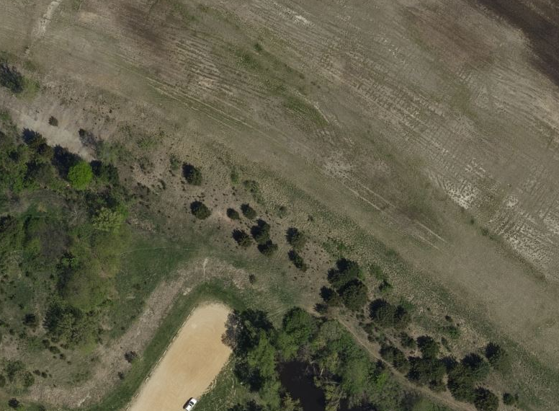
CBRN Run
Task: As a buddy team you must move the requested supplies (M2) from the start point to the finish point within 5 minutes.
Conditions: Given a battle buddy, 1x M2, and your protective mask.
Standards: Transport all M2 components to the top of the hill in your lane. Time Starts when any person on the team touches the supplies. Time stops when both team members have crossed the start line and all their items are at the top of the hill. Event will terminate at 5 minutes.
N
32M

Slide 18
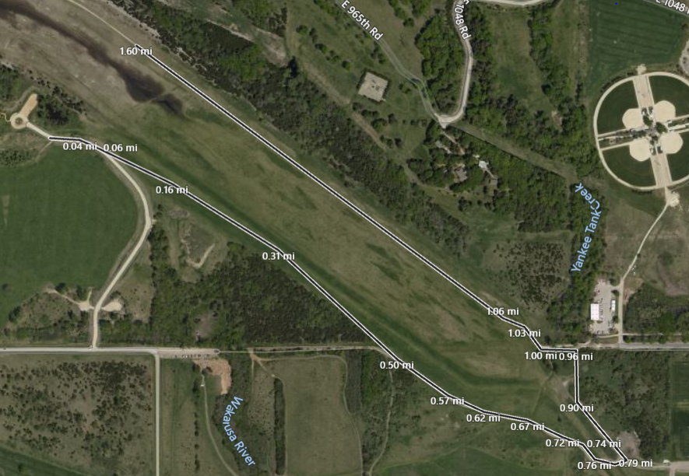
5K Buddy Run
Command Post
Checkpoint
Signage
Water point
Medical Pax/vic
Task: Teams will complete a 5K buddy run.
Conditions:
Team will remain in full uniform. All Tasks must be complete before starting.
Standards:
Complete the 5K course as a team with individual equipment in the shortest time possible.

